Slide 1
Ironhack Payments
Kerem Senler and Carlos R. Vidondo

Slide 2
Part 1: EDA

Slide 3
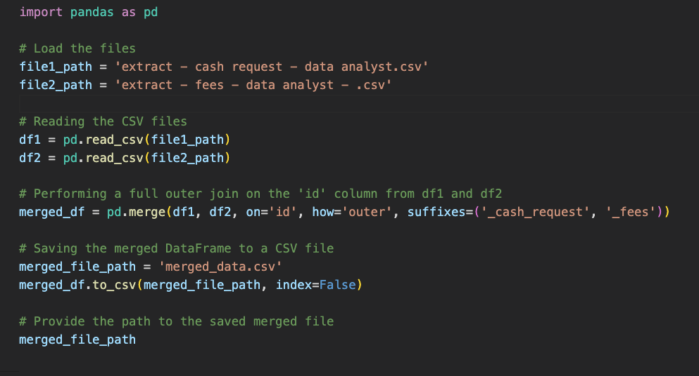

Step 1: Merging two files into 1 (outer join)
File 1
extract - cash request - data analyst.csv
Merged_data.csv
File 2
extract - fees - data analyst - .csv

Slide 4
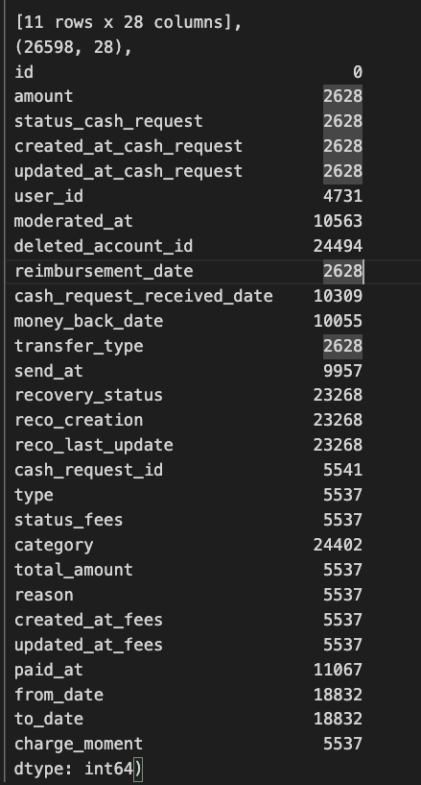
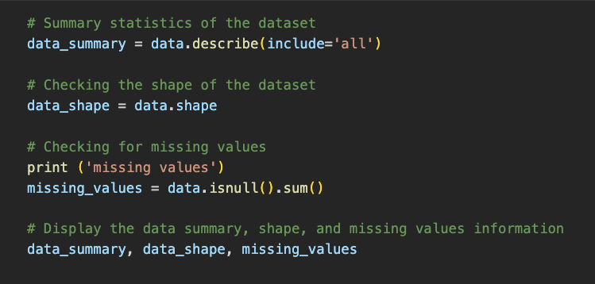
Step 2 (EDA): Data set structure and values
Dataset Structure:
- The dataset has 26,598 rows and 28 columns.
- Columns include details on transactions, user IDs, statuses, dates, amounts, and etc.
Missing Values:
Several columns have missing values.
Notably:
- *deleted_account_id has the most missing values (24,494).
- moderated_at, cash_request_received_date, money_back_date, and others also have significant amounts of missing data.
*Data cleaning needed

Slide 5
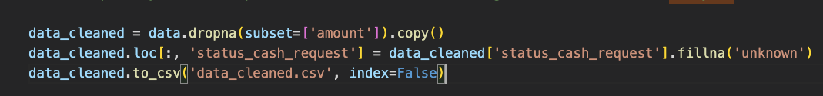
Step 3 (EDA): Data Cleaning
Find out which metrics is most import
‘Amount’ is the most important
data_cleaned.csv

Slide 6
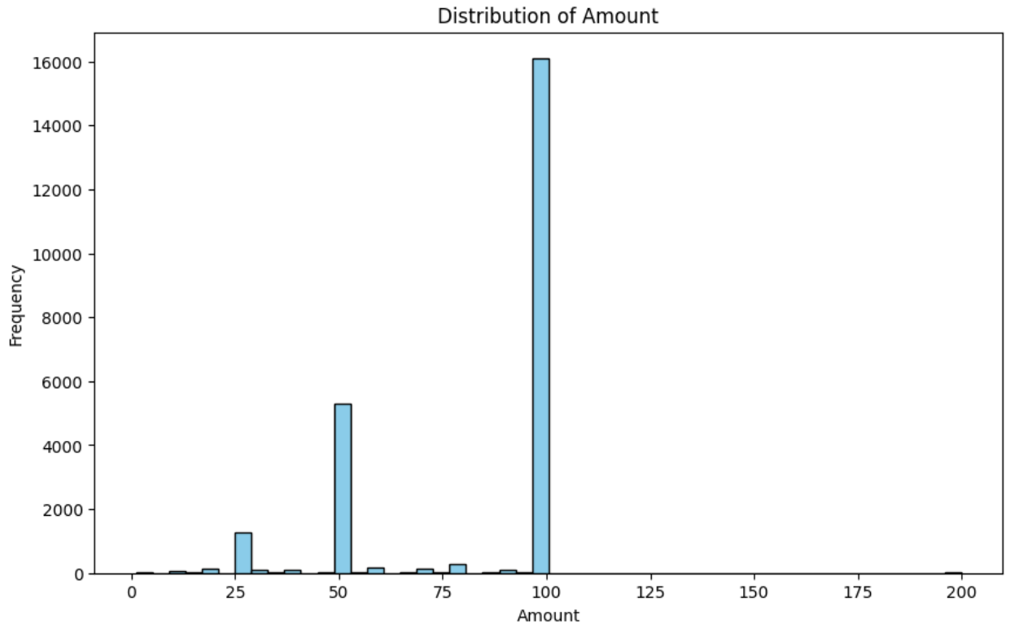
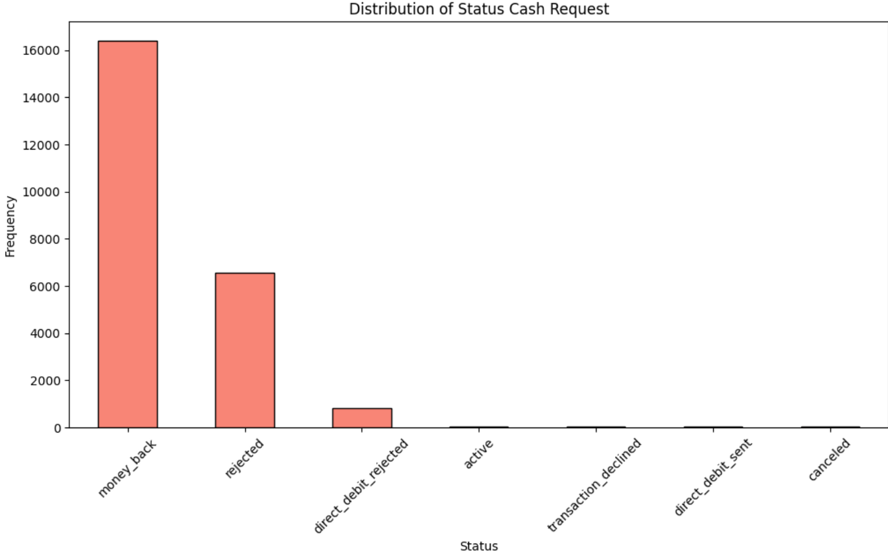
Step 4 (EDA): Visualizations and Distribution Analysis
Students mainly asked for the full amount (100)
Most of the money lended are paid back (reimbursed)

Slide 7
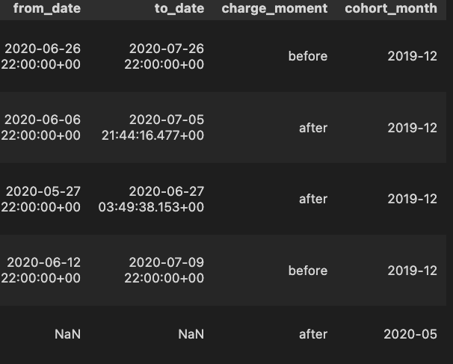
Step 5 (EDA) : Creating Cohort(s)
Create cohorts based on ‘created_at_cash_request’ metric (group the ones in the same month in Year+Month format.
Add this data as a new parameter (cohort_month) to data_cleaned.csv

Slide 8
Part 2: Metrics to analyze

Slide 9
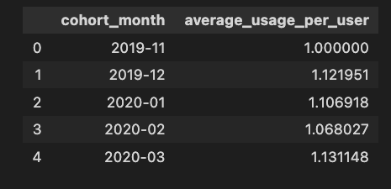
1. Frequency of Service Usage
Purpose: Understand how often users from each cohort utilize IronHack Payments' cash advance services over time.
Group by
cohort_month
user_id
Calculate average_usage_per_user based on cohort_month
Outcome: The table shows the average number of times users in each cohort used the service. For example, users from the cohort of December 2019 used the service on average around 1.12 times.

Slide 10
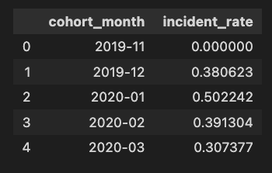
2. Incident rate
Purpose: Determine the incident rate, specifically focusing on payment incidents, for each cohort. Identify if there are variations in incident rates among different cohorts.
Group by
Create a new column
cohort_month
status_cash_request
Incident (if status_cash_request = ‘rejected’ )
Note: The reason only ‘rejected’ is counted that other values such as direct_debit_rejected and canceled are way too low in terms of numbers. We prefer to ignore them.
Outcome: Incident_rate indicates the rate of incidents (e.g., rejected requests) for each cohort. For example, the cohort from December 2019 has an incident rate of approximately 38%.

Slide 11
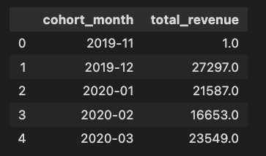
3. Revenue generated by cohort
Purpose: Calculate the total revenue generated by each cohort over months to assess the financial impact of user behavior.
Group by
rename the column
cohort_month
SUM(amount)
total_revenue (=SUM(amount))
Outcome: The table shows the total revenue generated by each cohort. For example, the cohort from December 2019 generated a total revenue of 27,297 units (Question: What are these units? USD? EUR?).

Slide 12
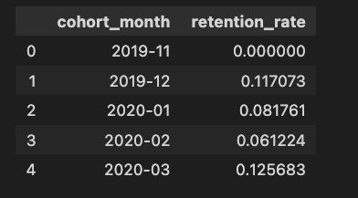
4. New Relevant Metric - Retention rate
Purpose: Propose and calculate a new relevant metric that provides additional insights into user behavior or the performance of IronHack Payments' services.
Create a new metric
Group by
Usage_count to identify users who made more than 1 transaction
cohort_month
Outcome: The table shows the percentage of users from each cohort who made more than one transaction. For instance, in the December 2019 cohort, approximately 11.7% of users made additional transactions after their initial request.

Slide 13
Part 3: Visualizations

Slide 14
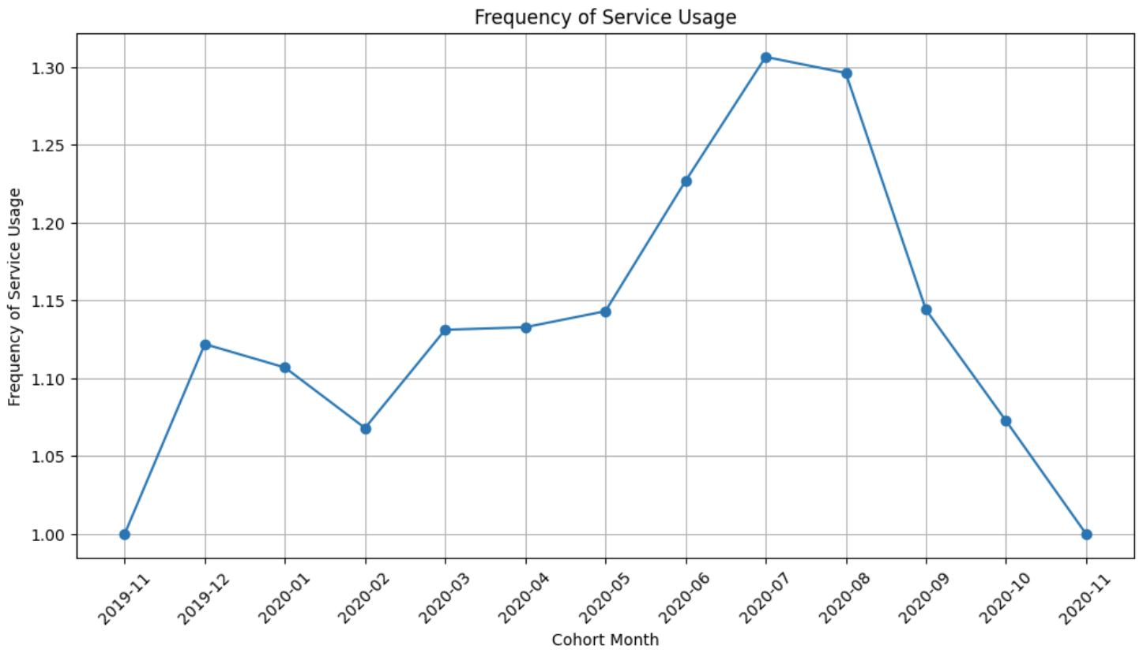
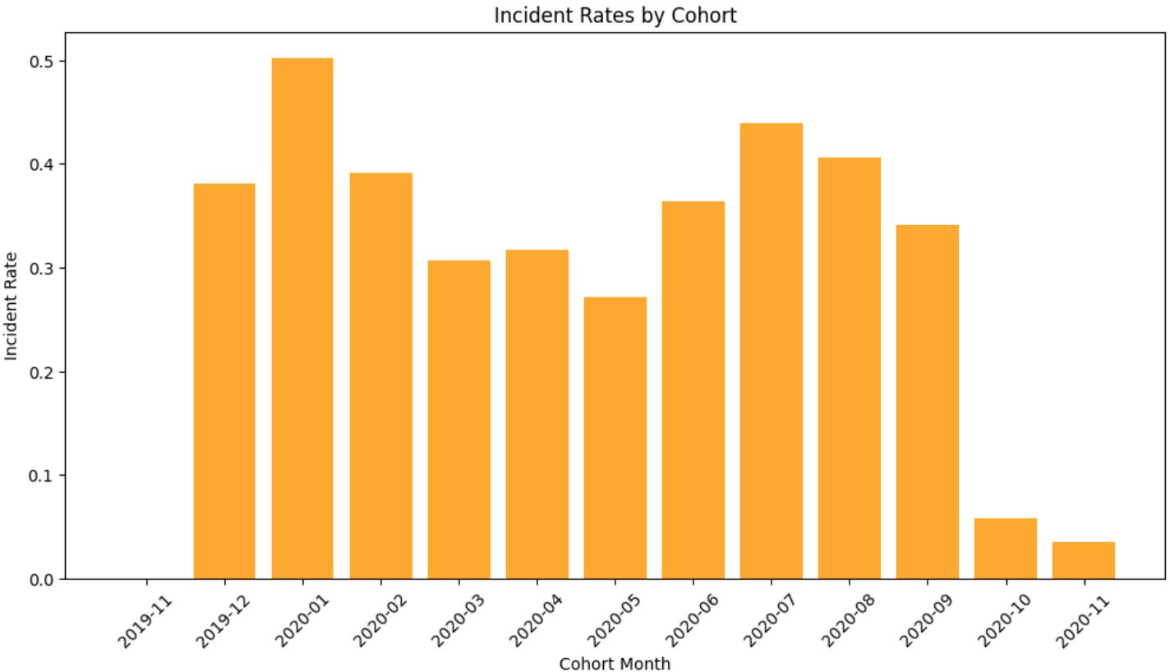
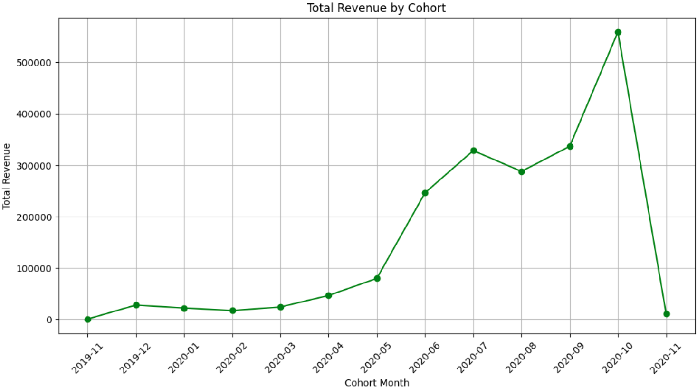
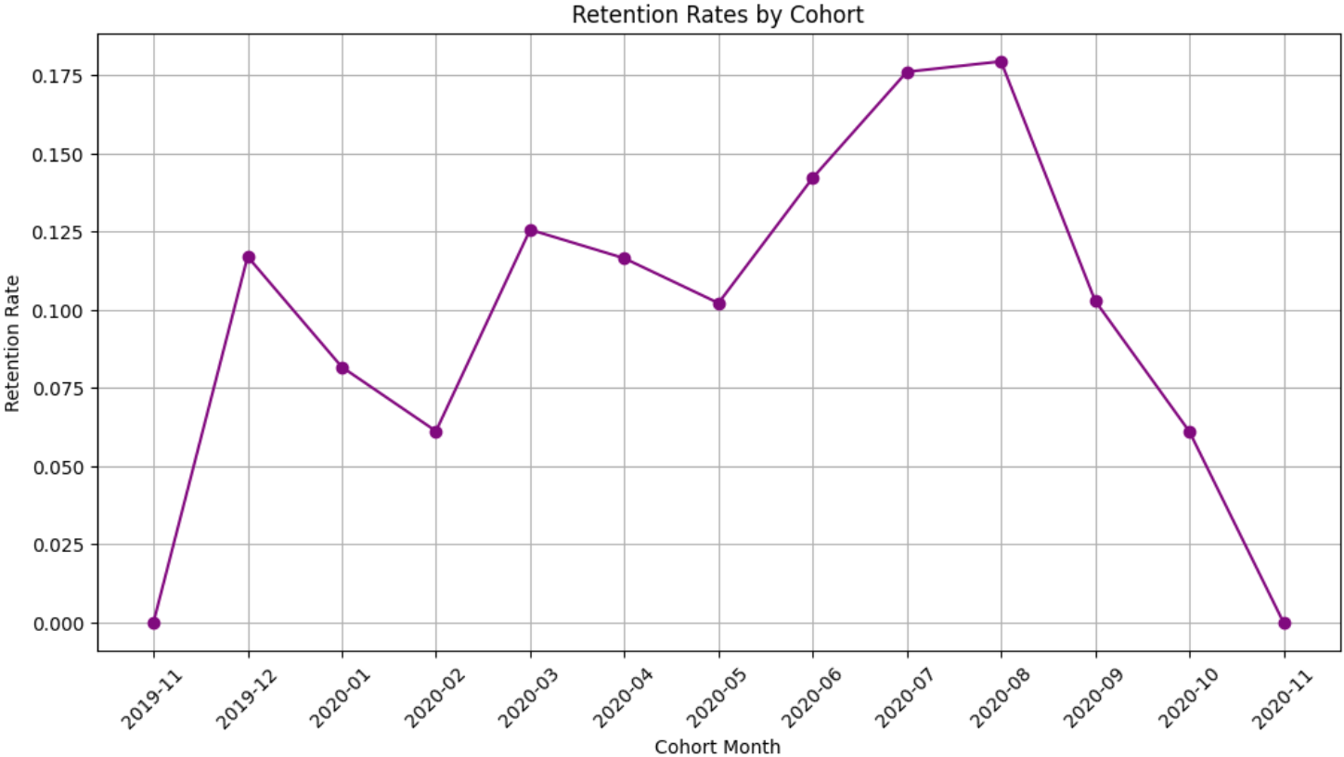
Piloting 4 metrics from the code

Slide 15
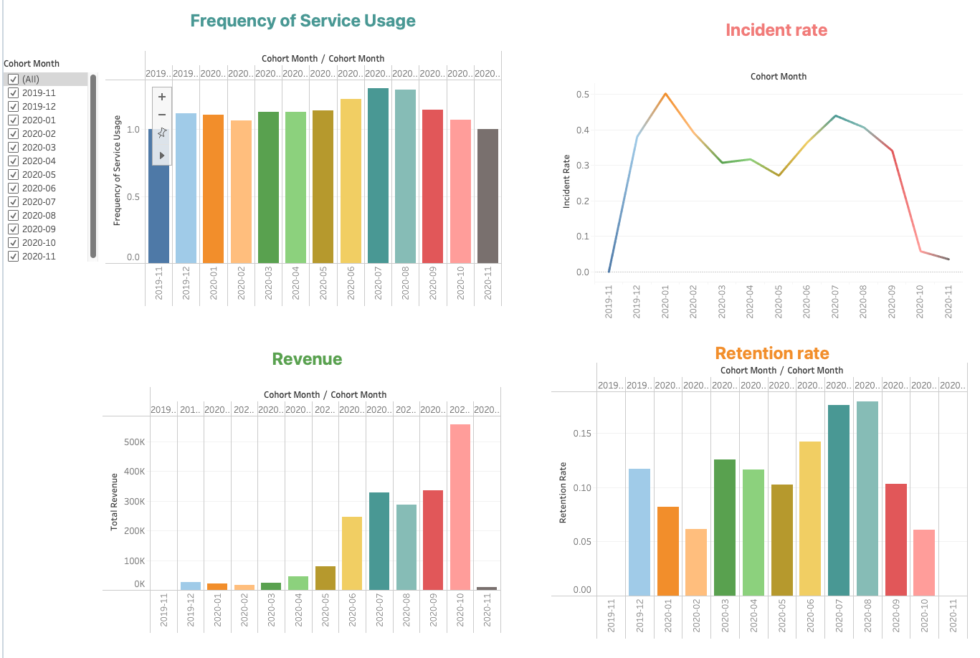
Tableau Dashboard

Slide 16
Part 4: Other deliverables

Slide 17
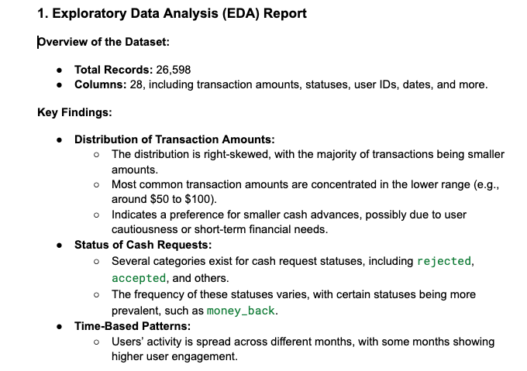
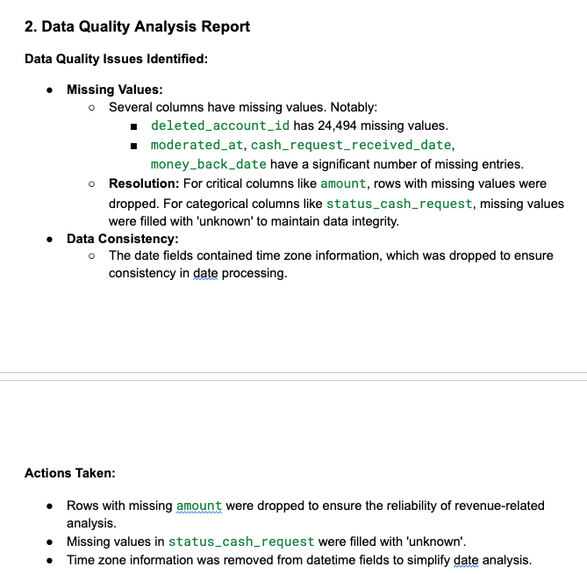
EDA and Data quality reports

